Slide 2
Tagliente Trasporti Srl

Slide 3
Who We Are
The "Tagliente Trasporti Srl“ operates in the transport and logistics products since more than 20 years on both domestic and European market. The initial business was the transportation of powders and granules for foods segment with silos and liquid foodstuffs in tankers. Encouraged by good results obtained the administrator decided to enlarge the activity becoming in few years a growing reference for the transportation of bulk chemicals.
Our mission is to ensure the full customers satisfaction

Slide 4
Services
Our company is able to satisfy through its fleet of vehicles, all property, the needs of different customers, both national and European level, ensuring high quality standards. For years our business has electively directed to the following industries:
Chemical industries
Plastic industries
Paper industries
Glass industries
Construction industries
Food industries (liquid and bulk)

Slide 5
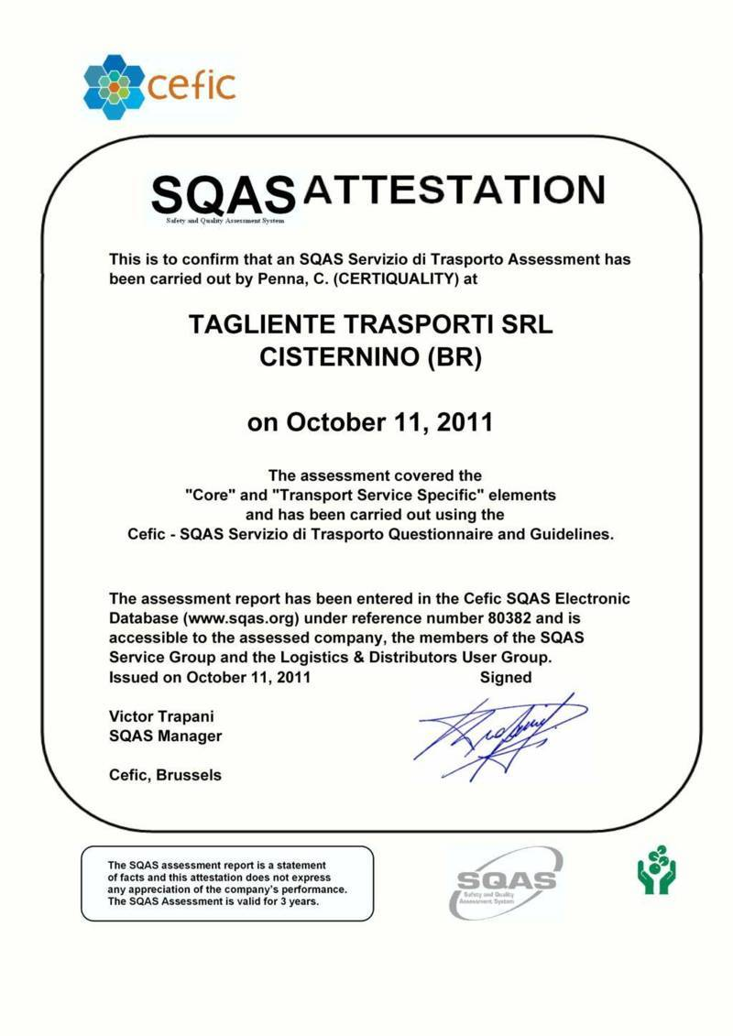
Certificates
In 2011, Tagliente Trasporti obtained from Certiquality the SQAS accreditation of its system in terms of quality, safety and environment.
SQAS Audit for Chemicals and ADR goods transport. We have passed the audit and we are listed in the SQAS public register: www.sqas.org transport service, which is an organization linked to CEFIC.

Slide 6
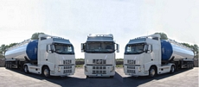
Fleet
Our company boasts a modern fleet, composed of silo from 56, 59 and 60 m³, with EURO 4 and EURO 5 engines, which allows us to offer our customers the transport of different types of bulk goods.
Road trucks : 6 units
Road trailers: 6 units

Slide 7
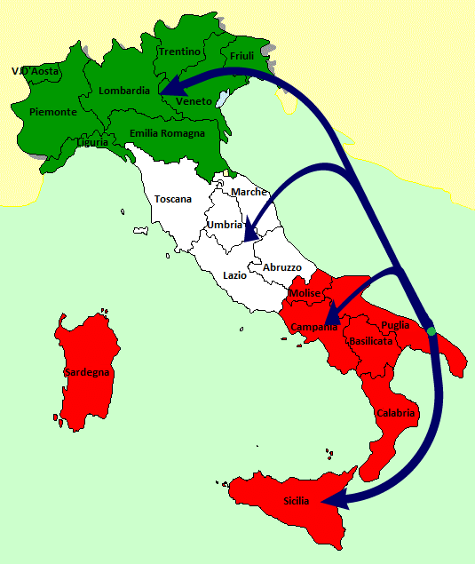
Strong Lanes
North Italy
Brindisi Central Italy
South Italy
Halfing (DE)
Brindisi Burghausen (DE)
Koln (DE)

Slide 8
Contacts
Headquarters:
Via Manzoni 4 – Cisternino – 72014 – Brindisi – Italy
Phone: + 39 080 4448289
Fax: + 39 080 4443231
Web: http://www.taglientetrasporti.com/
General Manager
Tagliente Angelo
a.tagliente@taglientetrasporti.com
Administration
Bartolo Loparco
b.loparco@taglientetrasporti.com
Administration
Angela Maria Zizzi
a.zizzi@taglientetrasporti.com

